Slide 1
DJ Simulator – Project Proposal
Student: Mac Baranowski
Project supervisor: Andreas Hoppe

Slide 2
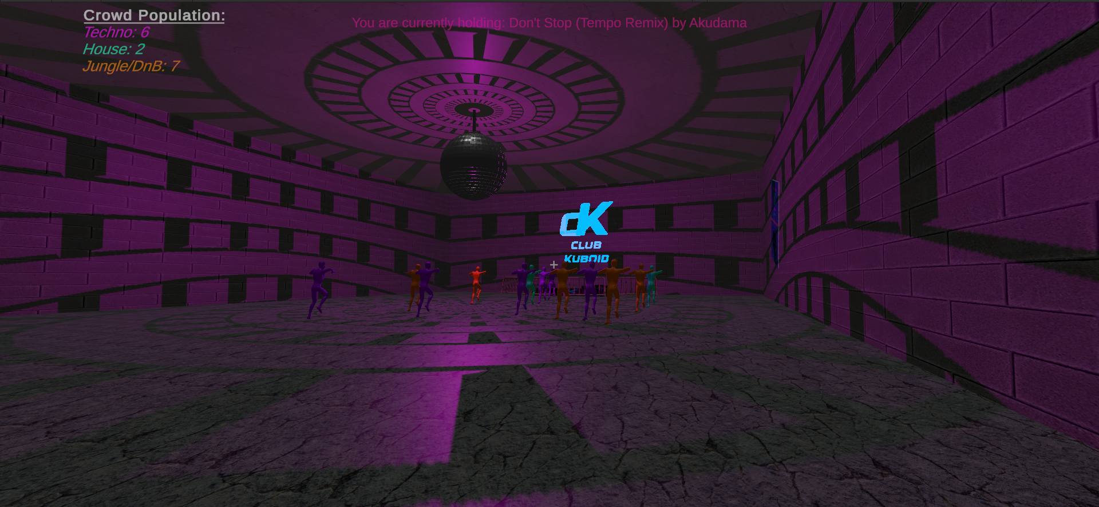
Game overview
You are a DJ that needs to make it big in the nightlife scene. To succeed, you must perform excellent DJ sets that score plenty of points. In order to gain points, you must ensure you are picking the right tracks for the crowd and that you are mixing the tracks smoothly. Can you become the best ranked DJ and climb the points ladder?

Slide 3
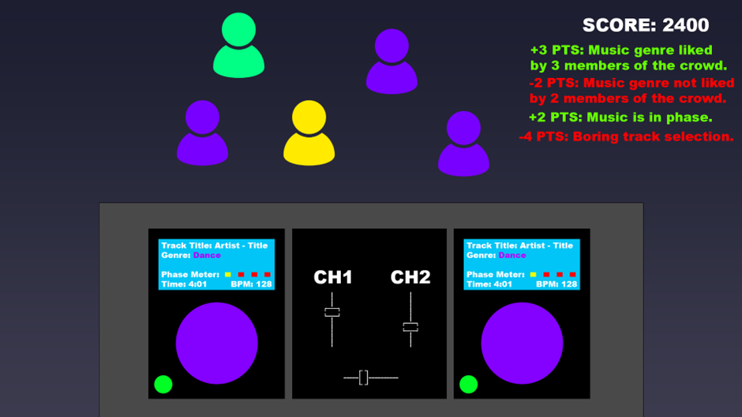
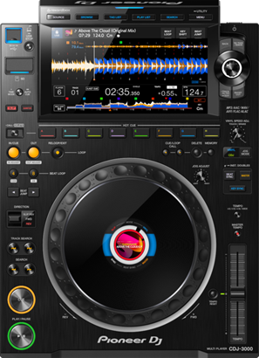
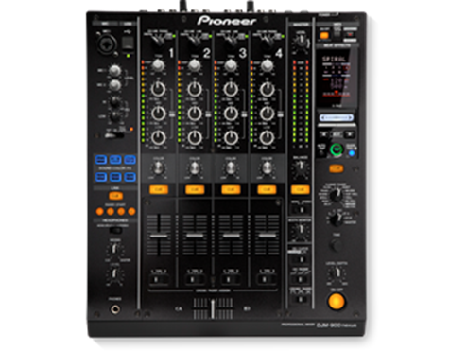
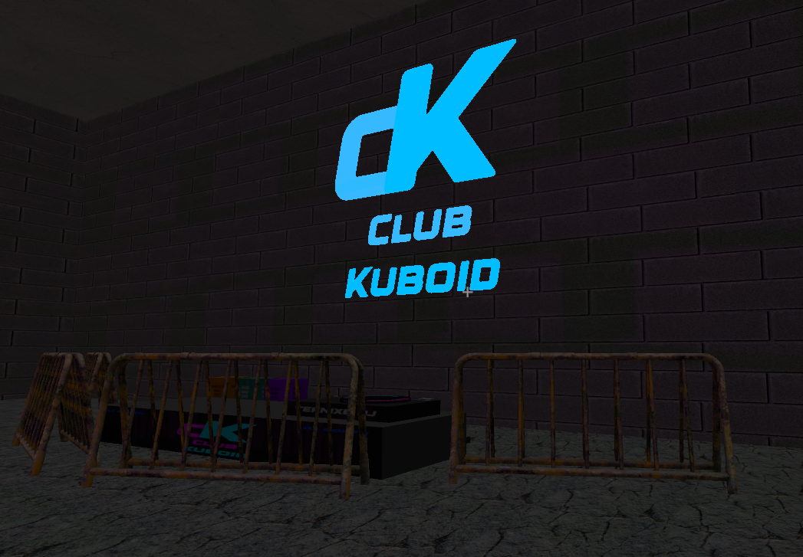
Game aesthetics
Fig. 1
Fig. 1: initial concept art for the game.
Fig. 2: screenshot from the in-engine prototype.
Fig. 3: image of club-standard equipment used by DJs.
Fig. 3
Fig. 2

Slide 4

Main game mechanic
Your view throughout the game will be of the DJ decks and of the crowd. The crowd will be colour coded based on the music that they like. The tracks that are being loaded onto the decks will also be colour coded based on their genre. The aim of the game is to score as many points as possible during a timed DJ set. There are multiple ways to gain (or lose) points.
Selecting tracks that appeal to the majority of the crowd will award points. As mentioned before, you must select genres of music that appeal to the crowd.

Slide 5
Feature requirements
An auto-balancing NPC system that ensures fair gameplay.
Dynamic points allocation algorithm that allocates points based on environment conditions and player performance.
An NPC ‘crowd’ that reacts to the environment and actions of the player.
A realistically modelled DJ turntable.
A categorised music library.
Audio-reactive environments.

Slide 6
MOSCOW analysis
MUST HAVE | SHOULD HAVE | COULD HAVE | WON’T HAVE
Diverse music library | Audio-reactive environment | Vinyl emulated slow-down/speed-up | Multiplayer
Controllable DJ decks | NPC animation | Controller support | Music importing
Reactive crowd | NPC engagement logic (leaving/ entering the room) | Tutorial
Points system |  | Multiple maps
NPC balancing manager |  | DJ mixer emulation

Slide 7
Technologies used
Unity is used due to its excellent multi-platform capabilities. Another reason that Unity is being used is due to the developer’s greater familiarity with the engine as opposed to Unreal. An LTS branch is being used due to greater stability. The game does not make use of the new features available in the latest Preview versions.
The target platform is PC. PS5 support is being strongly considered, however, due to the depth and complexity of the gameplay controls, it may not be feasible to adapt a control scheme specifically for the DualSense.

Slide 8
Development methodology
For the scope of a solo developer, the Agile methodology is the best approach to opt for. Considering the set of unusual features that this project contains, it is highly beneficial to see what features work well based on consistent and diverse user feedback.
This approach allows the developer to implement complex algorithms without becoming overwhelmed.
Considering the multitude of complex systems present in-game, it is important that new systems are developed in a way that allows them to function well with the ones already implemented. Agile methodology makes this easier via its iterative approach.

Slide 9

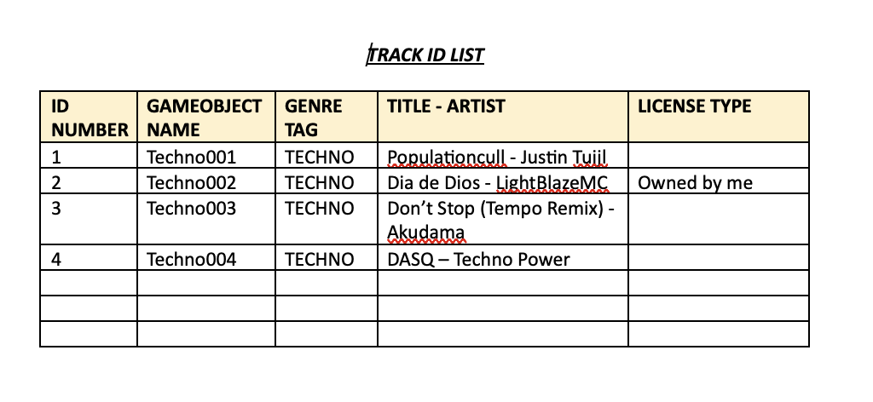
Ethical, Legal & Social issues and Data Security issues
The game rating is expected to be PEGI 12 – no themes of violence, gore or foul language are expected to be present in the game. The reason for a rating of ages 12 or higher is due to the depiction of nightlife.
Music is a core component of this game, and due to copyright reasons, all music will need to be composed by the developer so that first-party ownership can be guaranteed. Alternatively, music from guaranteed open-source, copyright-free sources can be utilised. A document tracking music sources and licensing will need to be used.

Slide 10
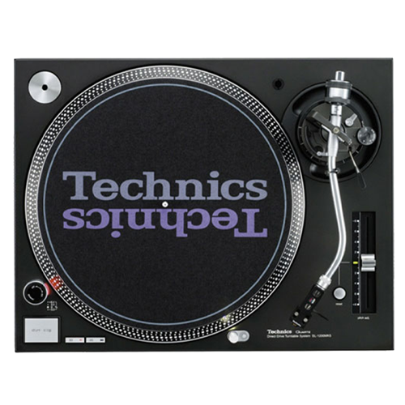
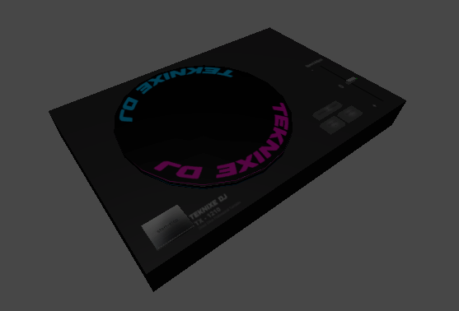
Future plans & schedule
Considering the complexity of emulating the proprietary operating system of Pioneer CDJ’s, it has been decided that a Direct-Drive Technics 1210 turntable will be implemented. The Technics 1210 is an analogue device, and thus emulating it is much easier and more likely to appear realistic. This change in hardware has already been reflected in the game prototype.
Better animations for the NPCs will need to be implemented in order to make the gameplay more immersive and realistic. NPCs should arrive and depart the room like in a real nightclub.
Fig. 1: Technics SL1210
Fig. 2: early prototype in-game emulation of the turntable.
Fig. 1
Fig. 2

Slide 11
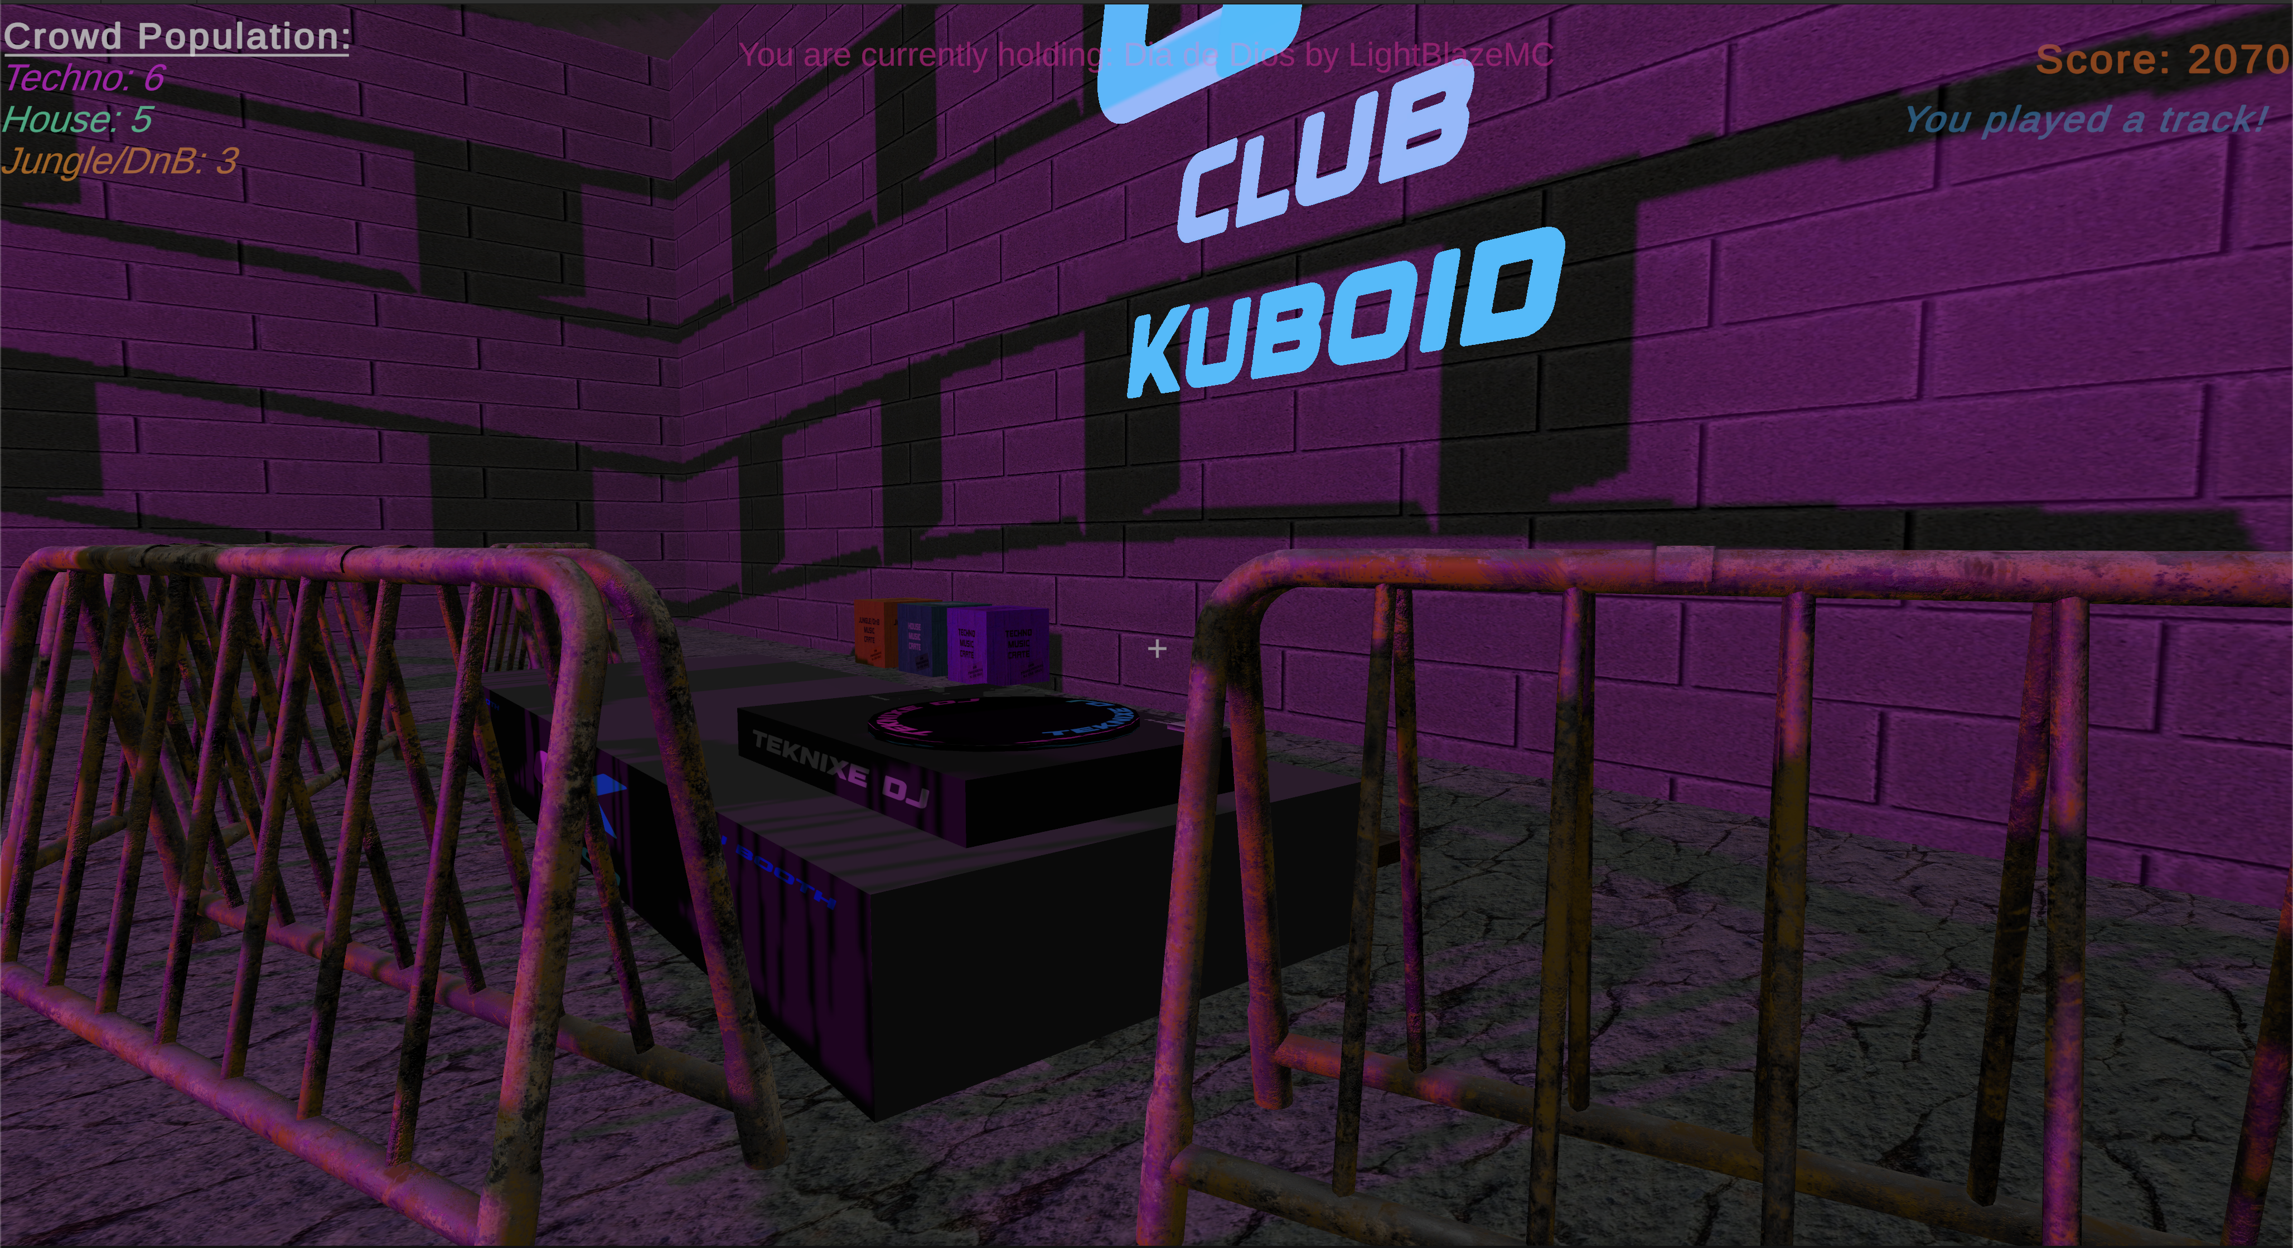
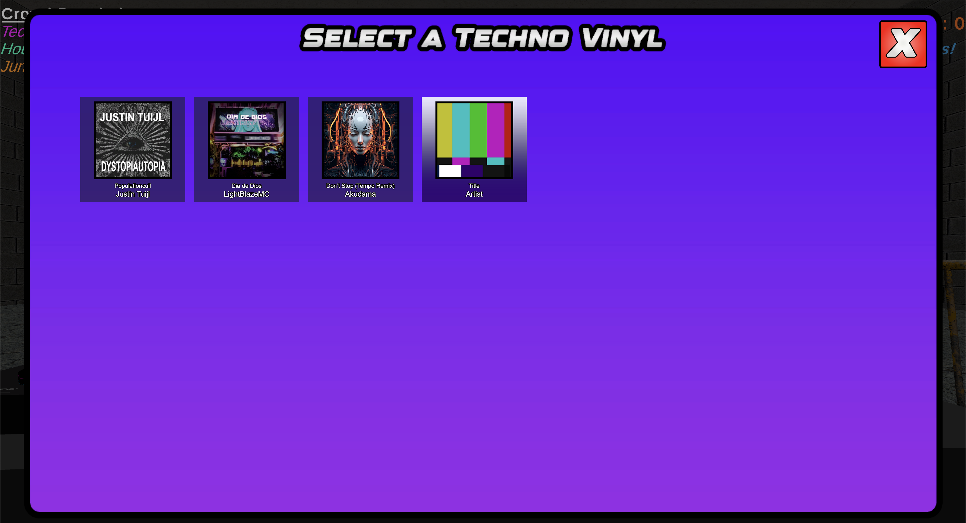
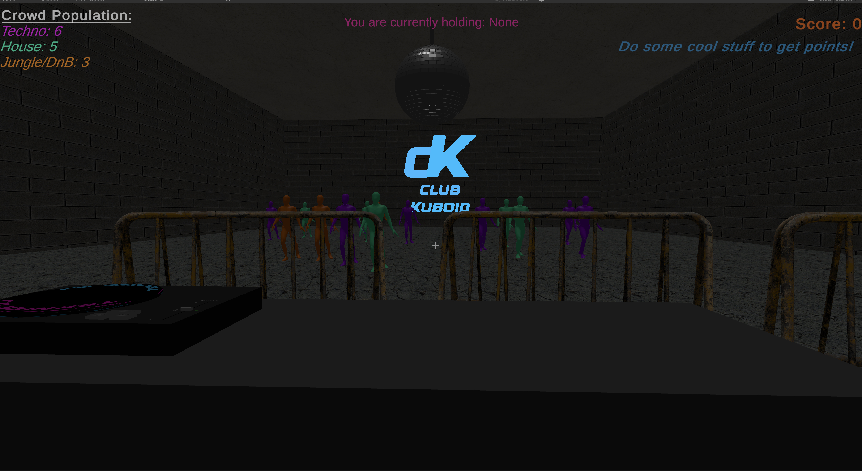
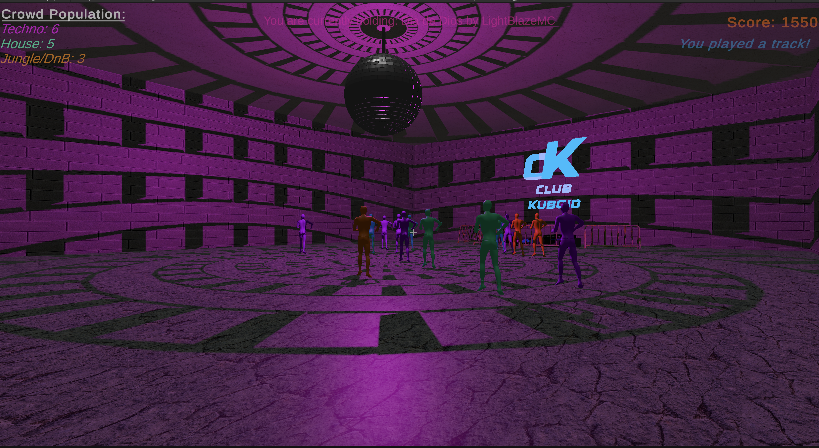
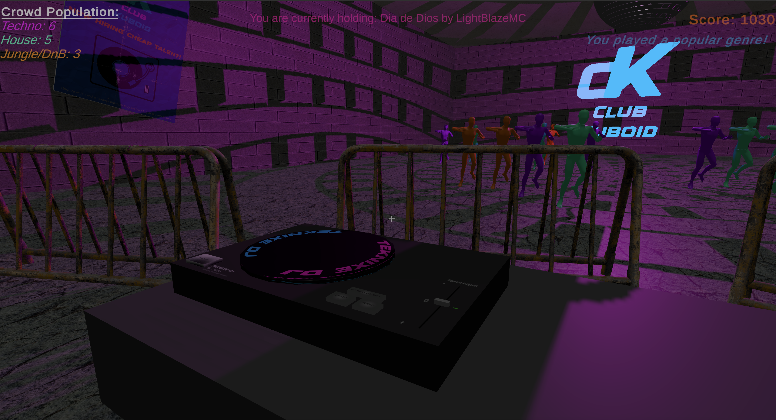
Gallery

Slide 12
References
Kolibri Games. (n.d.). Waterfall VS Agile Workflows - Kolibri Games Blog. [online] Available at: https://www.kolibrigames.com/blog/waterfall-vs-agile-workflows/.
‌Holland (2020). The Complete Technics SL1200 Turntable Guide - We Are Crossfader. [online] We Are Crossfader - Learn How To DJ Online. Available at: https://wearecrossfader.co.uk/blog/the-complete-technics-sl1200-turntable-guide/.
‌City of Melbourne Libraries (2021). Creating audio reactive visuals using Unity 3D - Tutorial 6. [online] YouTube. Available at: https://www.youtube.com/watch?v=ruq1Rfj7V3k [Accessed 4 Nov. 2024].
‌Jayanam (2018). Unity Tutorial: Open Panel on Button Click. YouTube. Available at: https://www.youtube.com/watch?v=LziIlLB2Kt4.
‌Hocking, J. (2018). Unity in Action : Multiplatform Game Development in C#. New York: Manning Publications Co. LLC.
‌pacha.com. (n.d.). Pacha Ibiza: The most emblematic nightclub of Ibiza. [online] Available at: https://pacha.com/.
‌www.minimalcollective.digital. (n.d.). How to build a club • A talk with rave architecture collective Temporary Pleasure | Minimal Collective. [online] Available at: https://www.minimalcollective.digital/editorial/how-to-build-a-club.
‌prointeriordesigner.com. (2011). Nightclub Design Planning Ideas and Concepts for Successful Design. [online] Available at: https://prointeriordesigner.com/hospitality-design/nightclub-design/.

